Slide 1

DriverPass
System Analysis
Stan U. Purcell
Modernizing the Driving Lesson Experience
Notes:
"Hello everyone, and thank you for taking the time to meet today. I am excited to guide you through the system architecture for DriverPass, our modern solution designed to streamline how your business manages driving student registrations, lesson schedules, and payments. My goal today is to showcase how this system is engineered to solve your operational challenges, create a painless experience for your students and instructors, and provide your management team with clear, actionable insights into business performance."

Slide 2

System Requirements
Core Core System Services (Functional):
  Self-service student registration and profile creation.
  Real-time open calendar booking and scheduling.
  Secure automated credit card payment handling.
  Business growth and revenue performance reports.
Platform Reliability Standards (Nonfunctional):
  Multi-core cloud server cluster with automated traffic management.
  Secure, high-speed corporate data storage system.
Notes:
"To build a strong solution, we categorized your business needs into two main buckets. First, we have what the system actually does for your users—the functional features. Students can quickly set up their own accounts, browse open times, and book lessons directly without having to call your office. Payments are automatically and safely processed the moment a booking occurs. For management, the system compiles automated reports that show your growth, busy times, and revenues.Second, we addressed how well the system performs behind the scenes. We are deploying this on premium cloud servers featuring automated balance controls. This ensures that even if hundreds of students log on simultaneously during peak morning hours, your website will stay fast, responsive, and completely crash-proof."

Slide 3
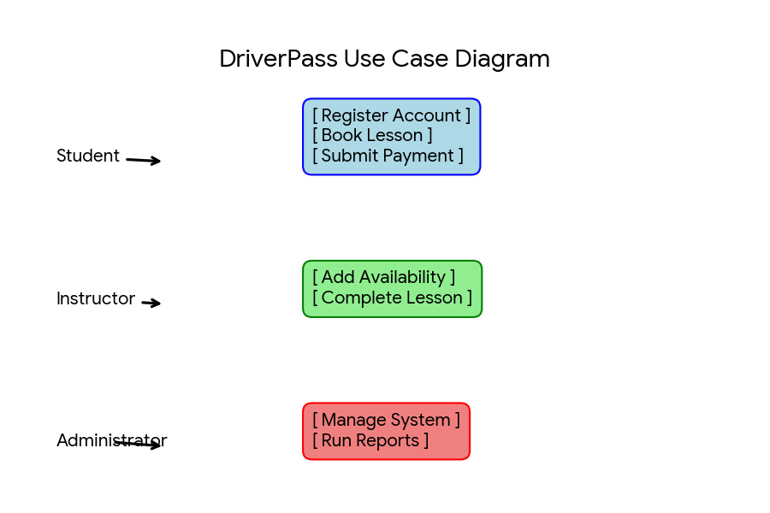
Use Case Diagram
[
Notes:
This diagram provides a high-level view of how different people interact with DriverPass. We break the users down into three groups: your Students, your Instructors, and your
Admins. As you can see on the blue path, students handle their registration, pick open spots from a calendar, and submit payments seamlessly. On the green path, your instructors have a dedicated way to publish the exact dates and times they are open to teach. Finally, the red path ensures your administrators can run the system and pull analytics reports whenever needed. This structure ensures clean boundaries; students only see what they need to book, instructors see their schedules, and you maintain complete control over the business data."

Slide 4
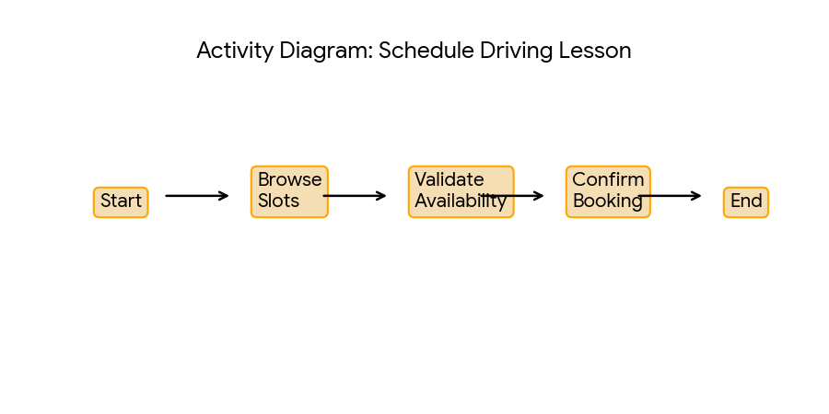
Activity
Diagram
[Insert one of your activity diagrams here.]
Notes:
"Let's take a look at what happens behind the scenes during a typical customer interaction. When a student browses your schedule, our system doesn't just blindly accept a booking. It instantly runs a verification check to ensure that the instructor is truly free and that no double-bookings can occur. Once verified, the booking is secured.Immediately after, our automated checkout sequence activates. The system securely collects the card information, sends it over a encrypted digital gateway to receive bank approval, updates your database, and instantly generates a digital receipt for the student. By making this a step-by-step automatic process, your administrative staff no longer has to manually verify schedules, collect card numbers over the phone, or write hand-written receipts."

Slide 5
Security
Bank-Level Transaction Security: All student credit card collections go through dedicated, certified payment gateways.
Role-Based Profile Boundaries: Users can only view and modify data relevant to their specific role (Student vs. Instructor vs. Administrator).
Isolating Core System Files: System code and configurations are isolated inside secure container units to block external vulnerabilities.
Notes:
"Security is vital when running a modern online platform. We have built-in triple-layer protection to keep your company safe. First, for credit cards, we use external secure payment gateways. This means card numbers are never sitting raw on your system, which eliminates major hacking risks and guarantees bank-level protection for your students.Second, we use strict profile boundaries. A student can never view another student's information or accidentally peek at internal administrative financial reports. Finally, we utilize modern server containers to package our code. If an external attacker attempts to disrupt one part of the platform, the container walls block them, keeping your central data and operations perfectly isolated and secure."

Slide 6
System Limitations
No Offline Capability: Continuous internet access is required to synchronize live availability and execute payments.
Structured Data Environment: Designed specifically around rigid relational metrics (such as unique IDs and text fields) rather than unorganized file processing.
Notes:
"To ensure transparent deployment, let's discuss the structural boundaries of our design. First, because this platform depends on split-second calendar updates and live financial approvals, it requires an active internet connection to work. If an instructor is out on the road in a deep dead-zone with no data signal, they won't see live, real-time schedule modifications until their mobile connection restores.Second, our underlying database is optimized for organized text, numbers, and dates—such as student accounts, IDs, certifications, and payment transaction logs. It is not an unorganized file dump for storing large, hours-long dashcam footage files or raw video recordings. Knowing these parameters allows us to focus the system's power entirely on what it does best: delivering a reliable, lightning-fast scheduling and billing experience for DriverPass."

